Slide 1






Introduction
Author 1 : Nova Nurviana
Author 2 : Jaka Sembiring
Author 3 : Henokh Lugo
SENTIMENT ANALYSIS TO MEASURE DEMOCRACY LEVEL
IN INDONESIA

Slide 2








The Importance of Democracy Index
To measure level of democracy in each province
To make a political plan based on the value of Democracy Index
As a comparison to other countries that employ democracy
$$IDI$$
It provides data to support study about democracy

Slide 3

Problem:
Delay 2 years between publication and last collected data
$\overline{x}$=2,3

Slide 4

Literature Review
(Lutz and
du Toit, 2014)
(Klaus and
Krieger, 2021)
(Bashar, 2019)
(Huda,2019)
(Faisal, 2020)
Measuring democracy from twitter using sentiment analysis
Using machine learning to conduct research about democracy indicator
Using Non Response Analysis to predict democracy value
Forecasting IDI 2018 Using Exponential Smoothing
Forecasting IDI 2019 Using Moving Average and Correlation between Aspect

Slide 5
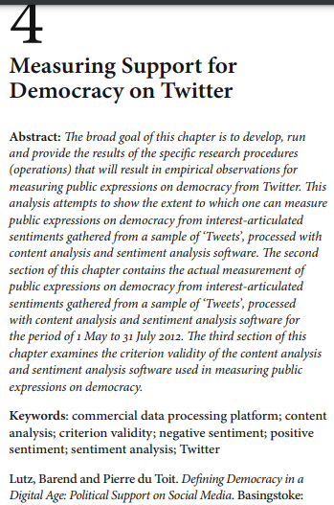



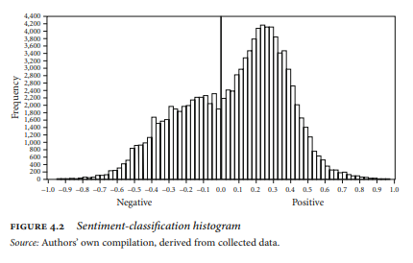
Literature 1

Slide 6
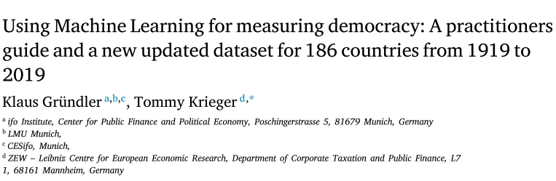
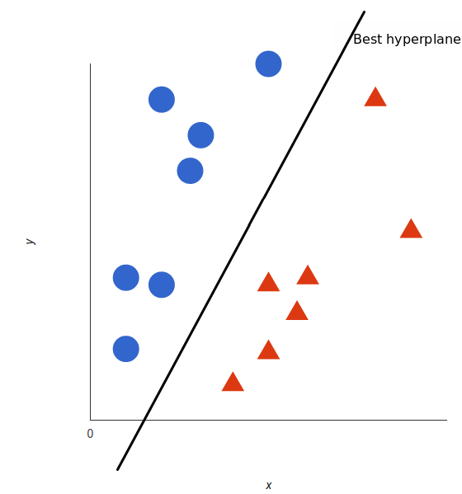
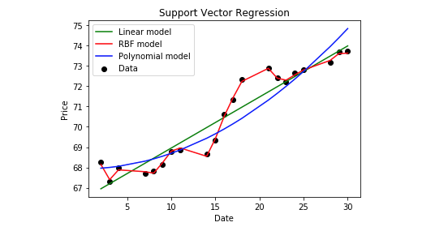
Literature 2

Slide 7
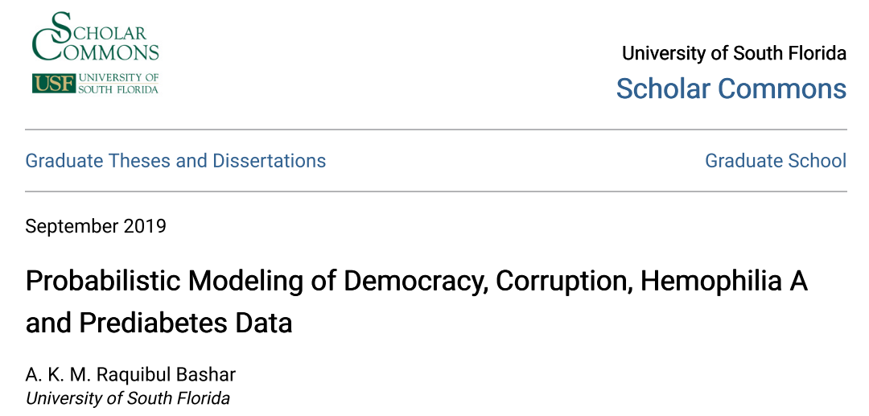
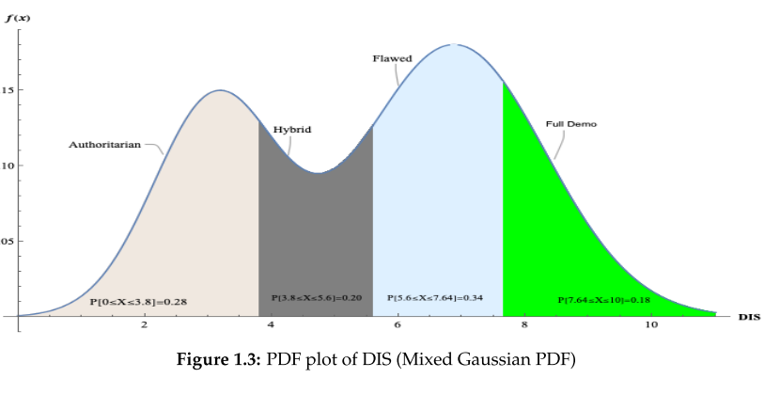
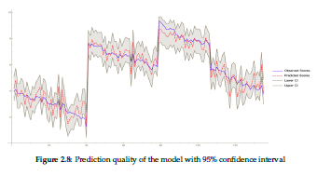
Literature 3

Slide 8
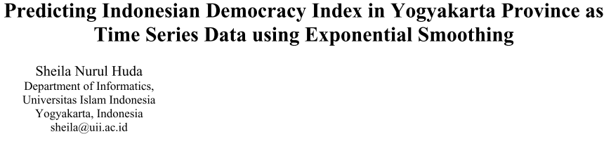


Literature 4
$$F_{t}=F_{t−1}+α(A_{t−1}−F_{t−1})$$
$$F_{t}$$ | : | Forecast value of t time
$$F_{t−1}$$ | : | Forecast value of t-1 time
$$α$$ | : | Constant
$$A_{t−1}$$ | : | Actual value of t-1 time

Slide 9
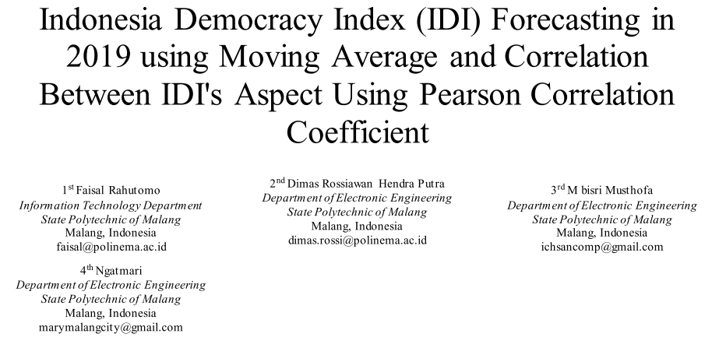
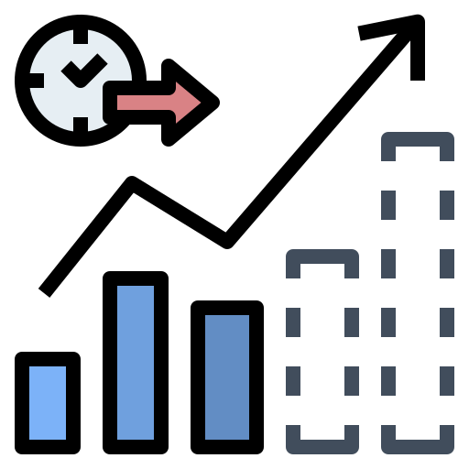



Literature 5

Slide 10
Literature Map
(Lutz,
2014)
(Nurviana, 2022)
(Bashar,
2019)
(Huda, 2019)
(Rahutomo, 2020)
(Grundler,
2021)
Measurement
Prediction

Slide 11


Indonesia Literature Map
Nurviana, 2022
Nurviana, 2022
Rahutomo, 2020
Huda, 2019
Measurement
Prediction

Slide 12

Hypothesis
The prediction of democracy level using sentiment analysis has higher time resolution than using regression of democracy index value
Sentiment analysis can be used as an alternative method to measure democracy level
We expect there is relation between democracy index and sentiment analysis where sentiment analysis can predict democracy index in any specific year

